Slide 1
ICDS Final Project
Rongyao Li rl4785
Kehan Luo kl4747

Slide 2
Introduction
1
2
Demo
CONTENTS
3
Discussion
4
Analysis
5
Improvement

Slide 3
1
Introduction

Slide 4
1
Introduction—— Motivations
Graphical User Interface | Develop a GUI for the chat system.
Online Game | Create an easy online game to add some fun to the chat system.

Slide 5
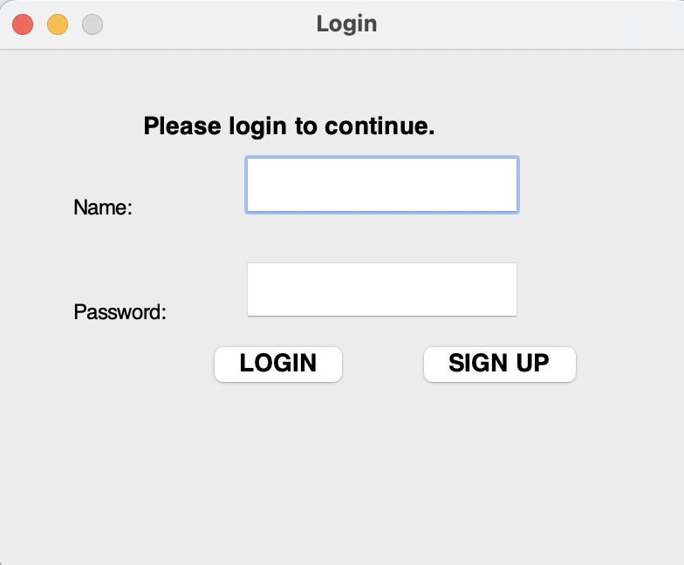
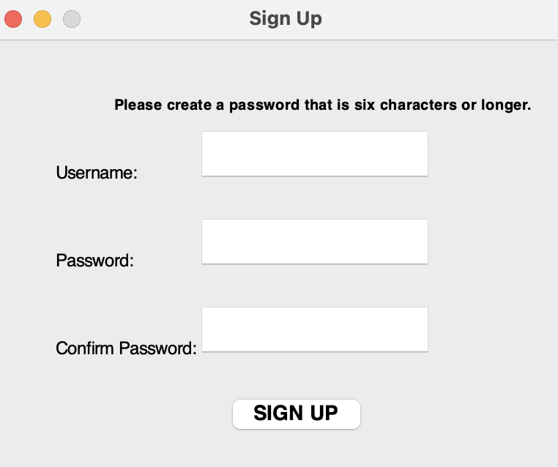
1
Introduction—— GUI

Slide 6
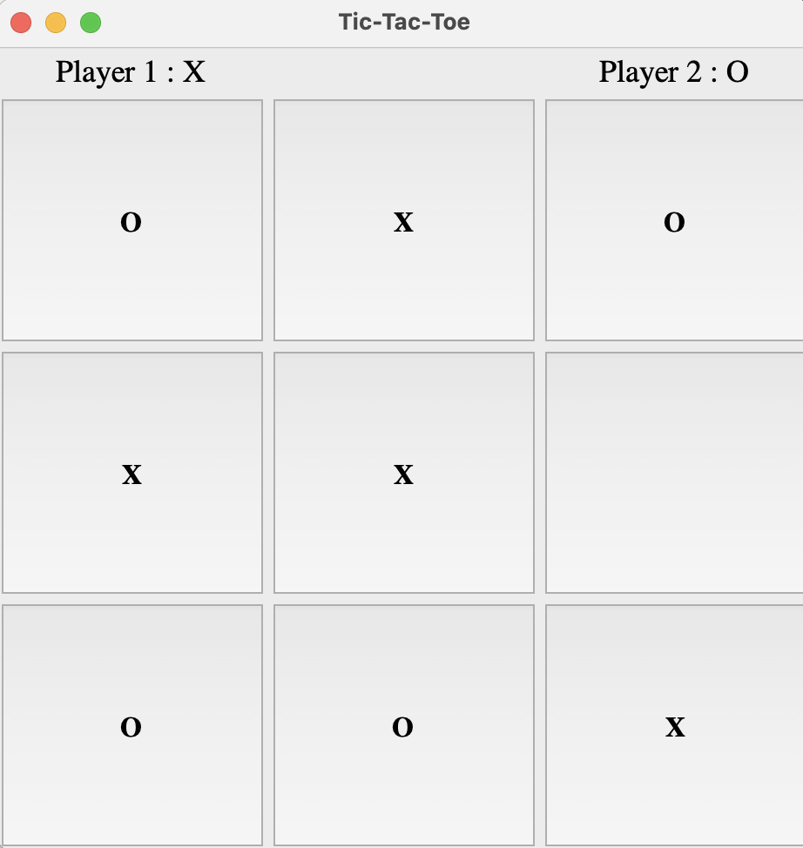
1
Introduction
—Game

Slide 7
2
Demo

Slide 8
3
Discussion

Slide 9
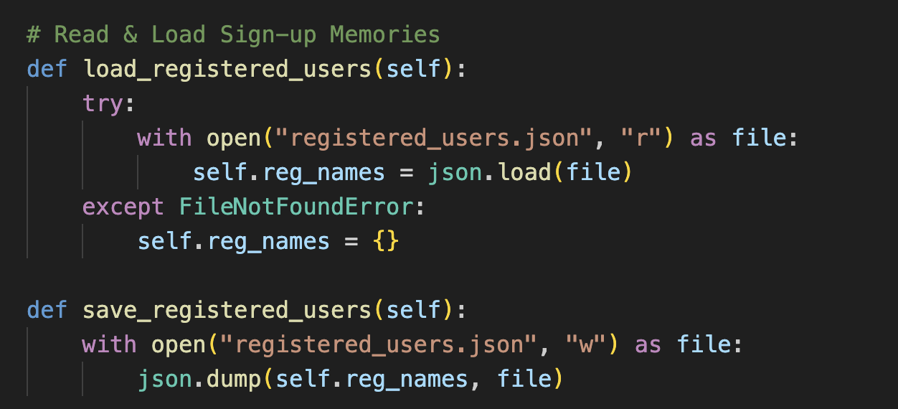
3
Discussion—— GUI
Sign-up Memory
The sign-uped message will be saved as a dictionary in “registered_users.json”.

Slide 10
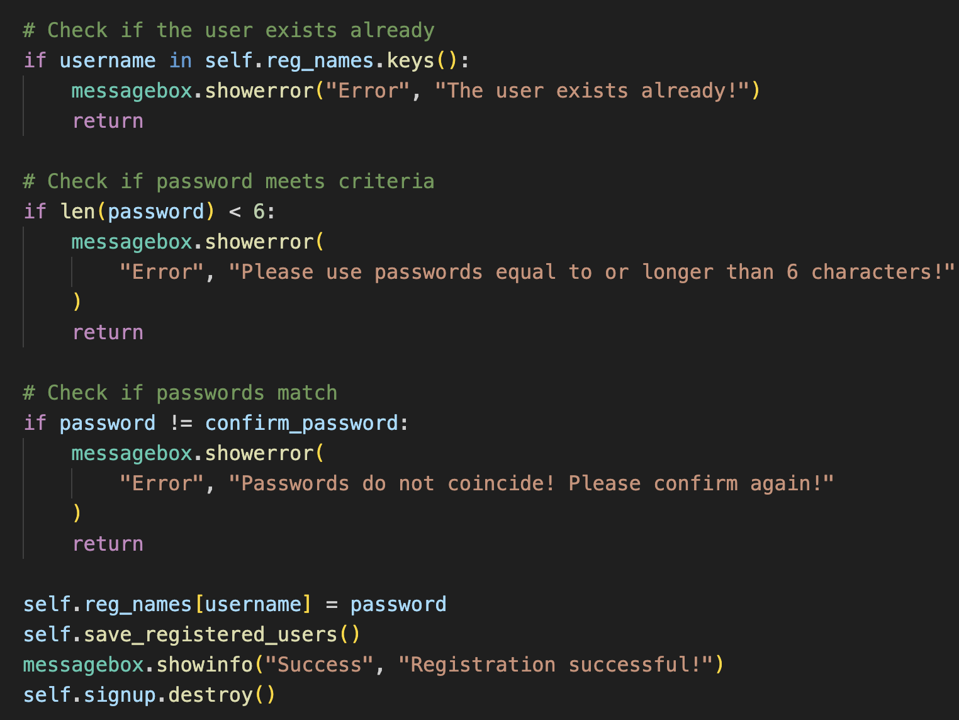
3
Discussion—— GUI
Sign-up Algorithm
We added a condition for the length of password.

Slide 11
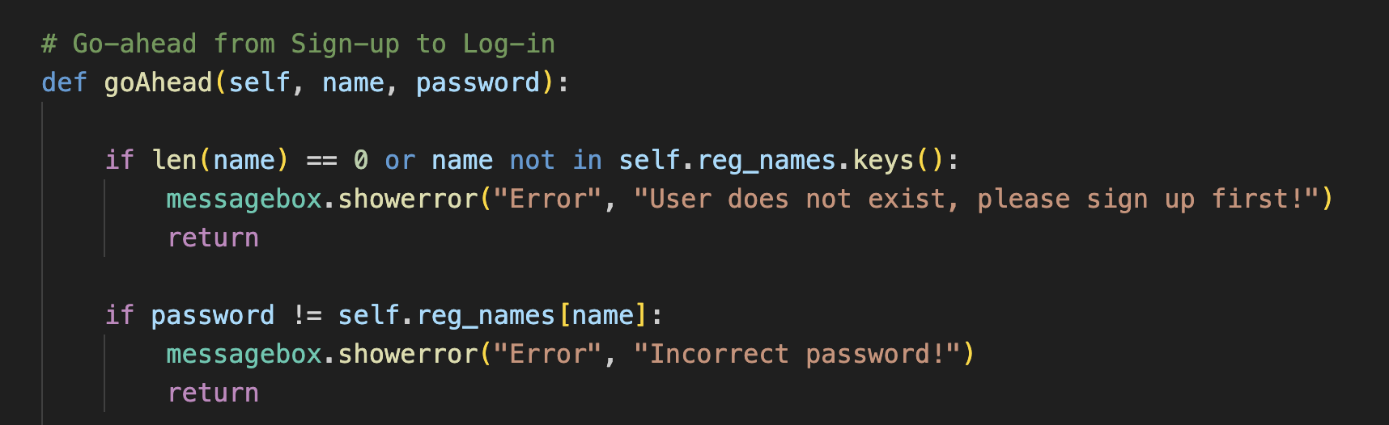
3
Discussion—— GUI
Log-in Window

Slide 12
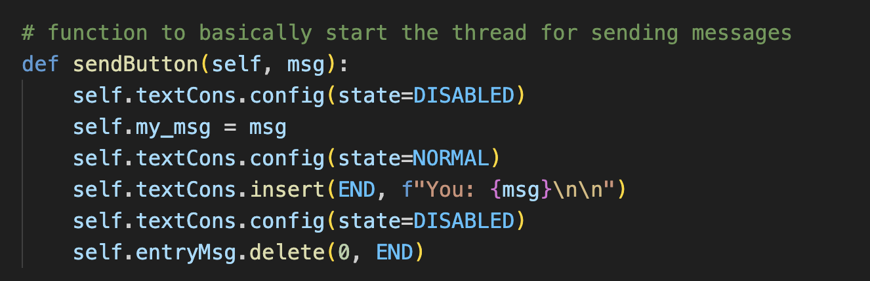
3
Discussion—— GUI
Chat Window
We updated the Chat Window so that users can see their own messages.

Slide 13
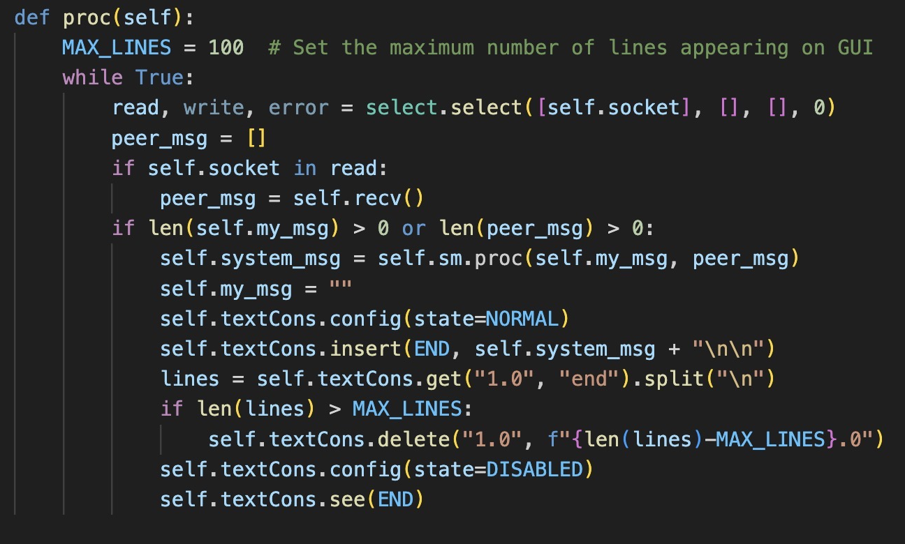
3
Discussion—— GUI
Chat Window
We updated the Chat Window so that previous messages will not appear repeatedly.

Slide 14
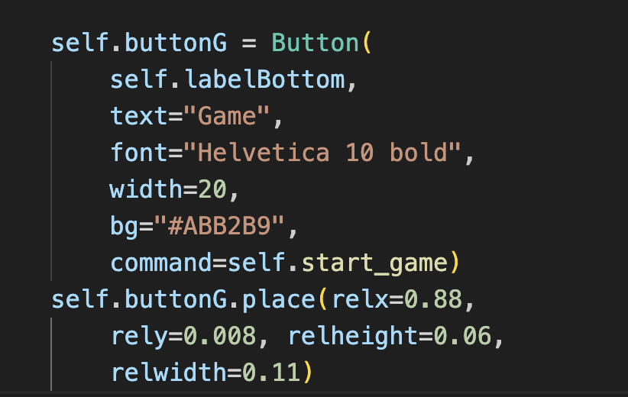
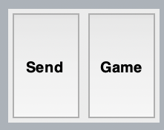
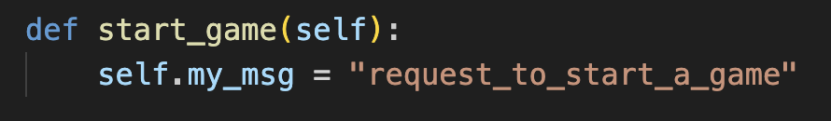
3
Discussion—— Game Tic Tac Toe
Interface

Slide 15
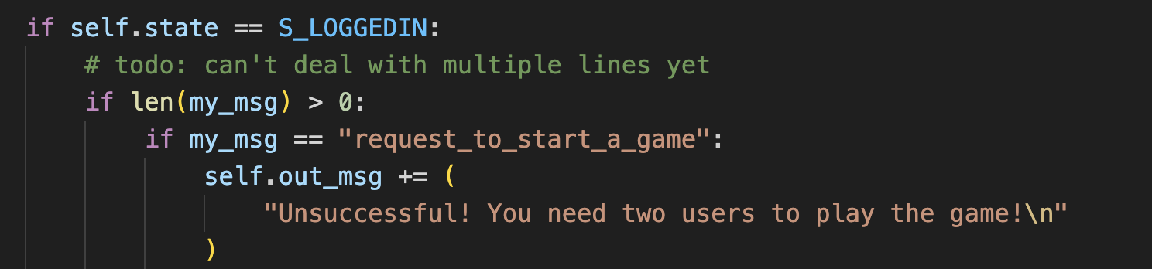
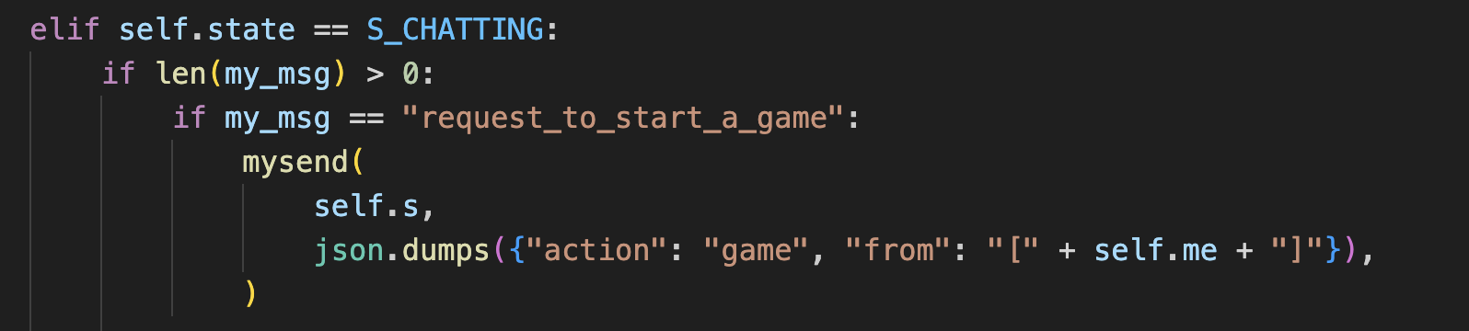
3
Discussion—— Game Tic Tac Toe

Slide 16
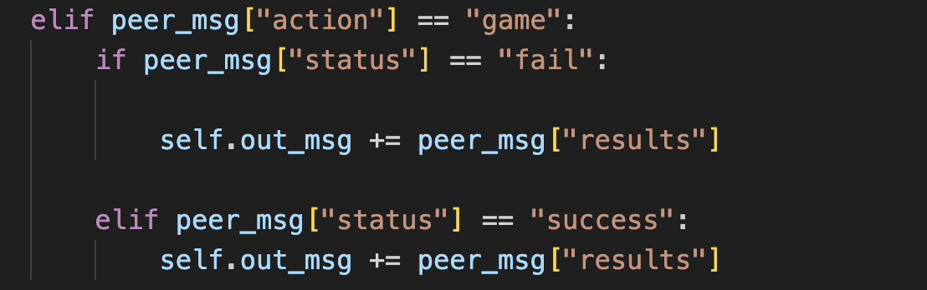
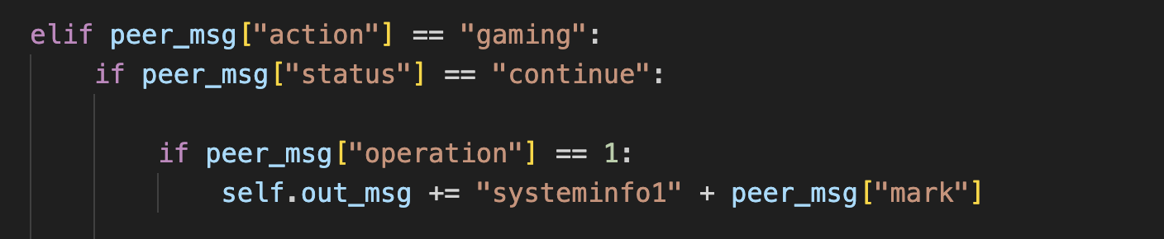
3
Discussion—— Game Tic Tac Toe
Client_State_Machine will update the clients’ states into “gaming”.

Slide 17
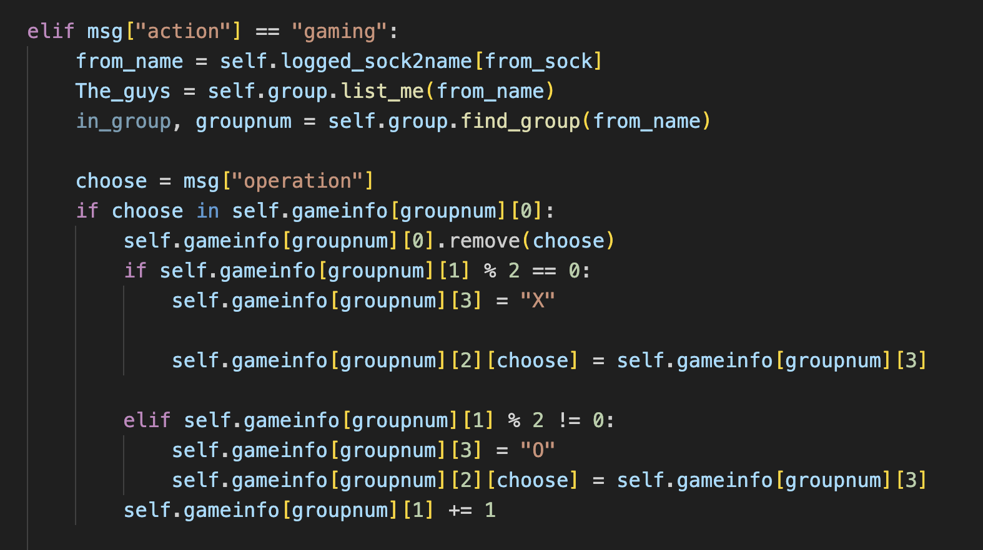
3
Discussion—— Game Tic Tac Toe
Chat server will connect these two users to the game.

Slide 18
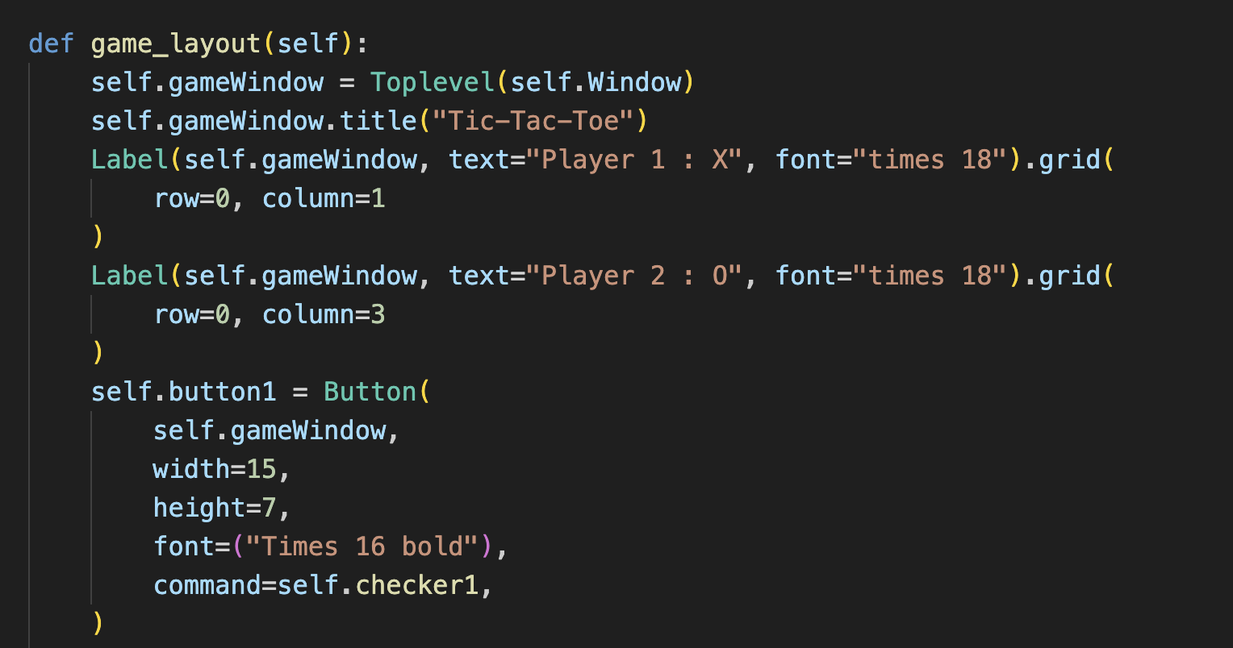
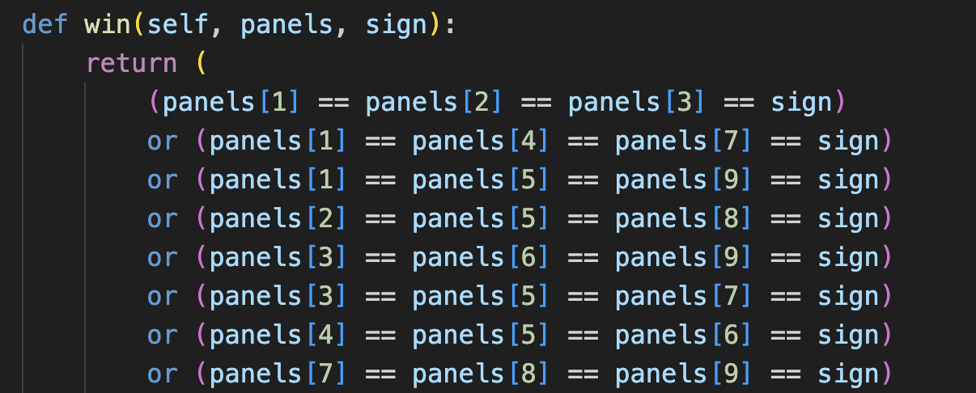
3
Discussion—— Game Tic Tac Toe

Slide 19
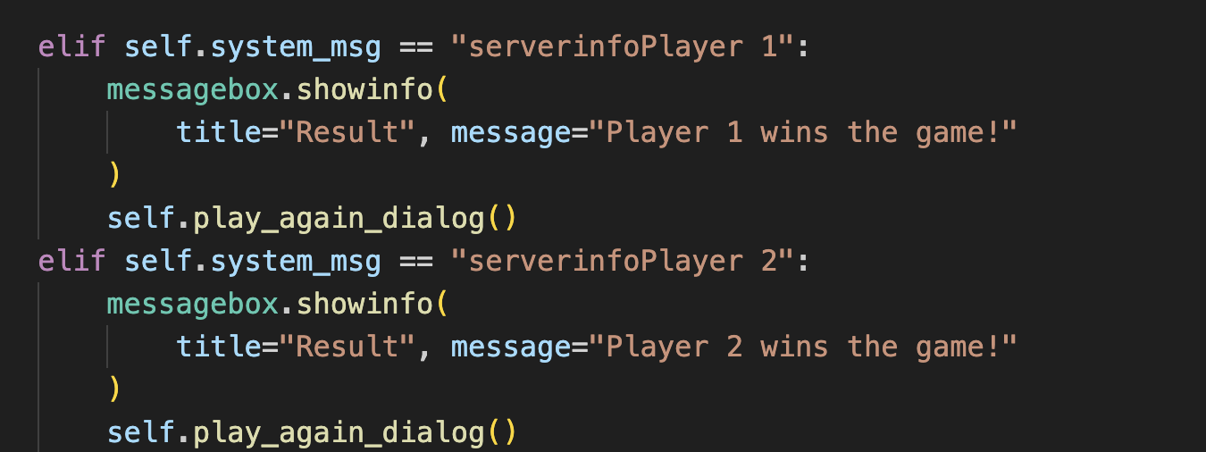
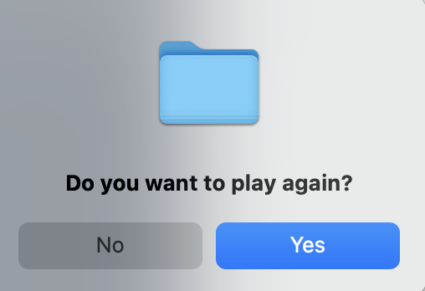
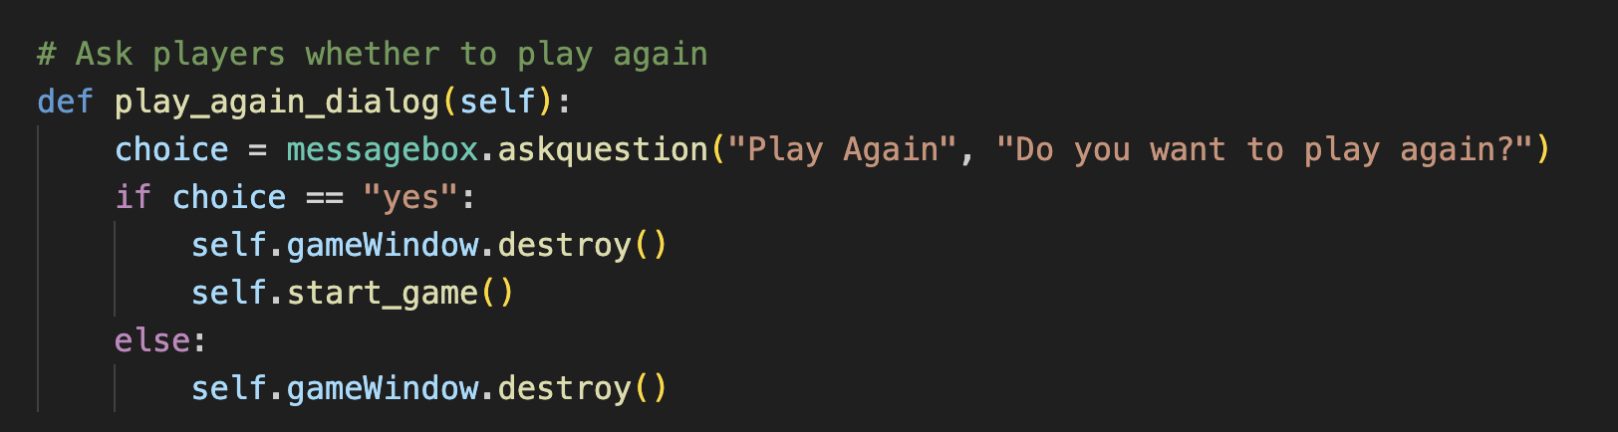
3
Discussion—— Game Tic Tac Toe

Slide 20
45
Analysis
Improvement

Slide 21
4
Analysis & Improvement
Security & Reliability
Online Game

Slide 22
Thank You!
Feel free to contact if you have any questions!
rl4785@nyu.edu
kl4747@nyu.edu

